Slide 1
Speaking and writing activity

Slide 2
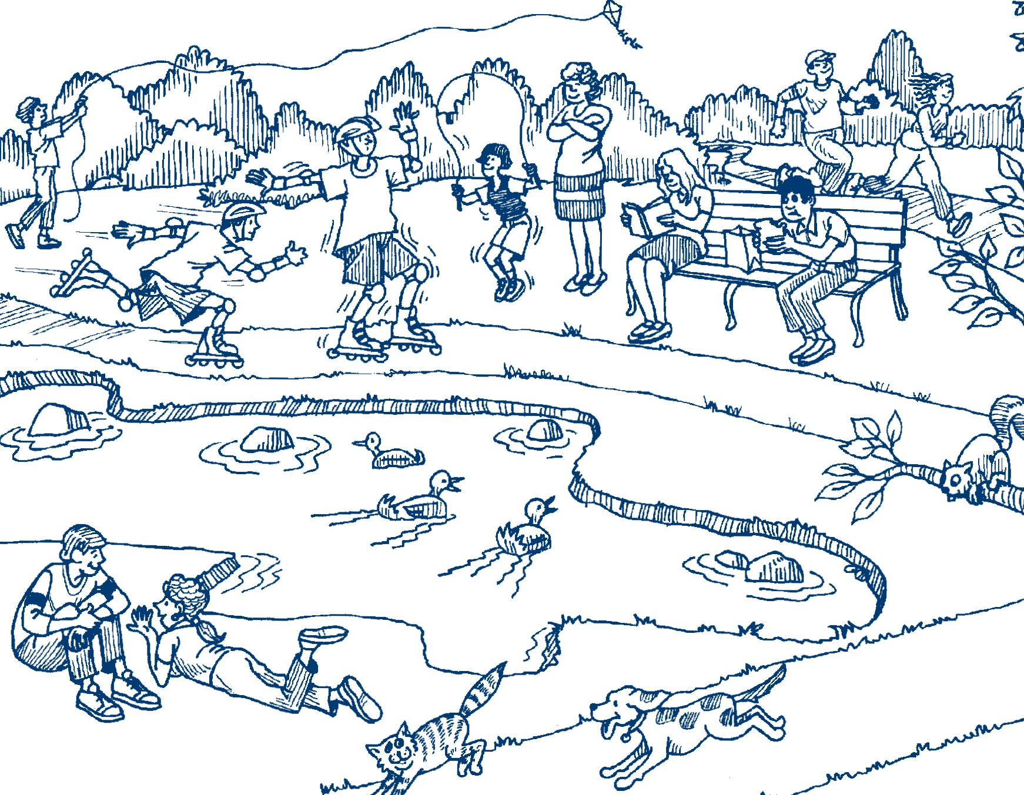

Slide 3
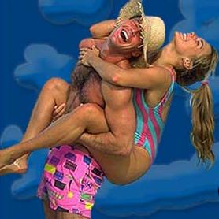


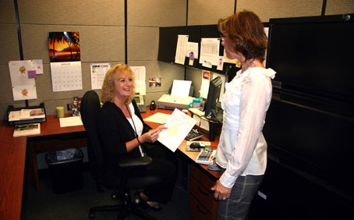
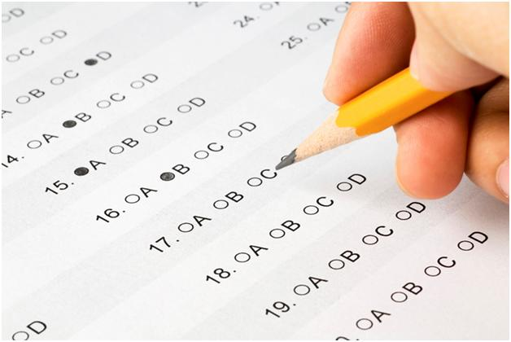
What´s your name?
How are you doing?
Where are you studying English?
Why are you studying English? I am studying English…
What are you learning in your English class?
How are you doing in your English class?
I´m doing great/okay ☺
I´m doing so-so (+/-)
I´m doing terribly ☹
What are you doing this week?
For my major
For fun
Because I want to travel
For my job
For an exam

Slide 4
Reasons to study english:
For fun
Major
Travel
Job

Slide 5
1. _________________?
No, I´m studying at ICPNA.
2. ________________?
No, I´m not working.
3. _______________?
Yes, he is. He is cooking lunch.
4. ________________?
Yes, she is. Lala is singing on T.V.
5. _______________?
No, they aren’t. They are listening to the teacher.
6. Are you drinking Pepsi?
__________________
7. Is your teacher eating?
___________________
8. Are you talking on the phone?
___________________
9. What are you doing now?
____________________
10. What is your mother doing in this moment?
____________________

